Slide 1
Wireless Communication
Komal Domadiya

Slide 2
WIRELESS COMMUNICATION
Wireless communications is the system which are using radio-frequency, infrared, microwave, or other types of electromagnetic waves in place of wires, cables, or fibre optics to transmit signals or data.
Wireless devices include cell phones, two-way radios, remote garage-door openers, television remote controls, and GPS receivers.
Wireless modems, microwave transmitters, and satellites make it possible to access the Internet from anywhere in the world.
Transmitting/receiving voice and data using electromagnetic waves in open space.
The information from sender to receiver is carried over a well defined channel.
Each channel has a fixed frequency bandwidth & capacity(bit rate).
Different channels can be used to transmit information in parallel and independently.

Slide 3
Wireless communication
Requirements of Wireless Communication
Freedom from wires.
No bunch of wires running from here and there.
“Auto Magical” instantaneous communication without physical connection setup
e.g.- Bluetooth, Wi-Fi.
Global coverage Communication can reach where wiring is infeasible or costly
E.g.- rural areas,buildings,battlefield,outerspace.
Stay connected,flexiblity to connect multiple devices.

Slide 4
Wireless communication system
Input Transmitter path
Output Receiver Path
Source
Source Encoder
Channel Encoder
Modulation
Channel
Information
Source Decoder
Channel Decoder
Demodulation

Slide 5
Contin..
The transmitter receives the information from the source and encodes it by using a source encoder.
The source encoder is used to encode the message from the source into a continuous stream of bits. (methods for source encoding are waveform, linear predictive coding)
The channel encoder encodes the signal for error correction and detection by adding some redundant bits.(methods for channel encoding are hamming codes, block codes etc)
The encoded signal is modulated by using the digital modulation schemes such as binary phase shift keying, quadrature phase shift keying, minimum shift keying etc..
The receiver demodulates and decodes(channel decoding and source decoding) the signal to obtain the transmitted information.
The main design goals of the transmitter and the receiver are to decrease the distortion and noise from the channel

Slide 6
Types of Wireless Communication
Today, people need Mobile Phones for many things like talking, internet, multimedia etc. All these services must be made available to the user on the go i.e. while the user is mobile. With the help of these wireless communication services, we can transfer voice, data, videos, images etc.
Wireless Communication Systems also provide different services like video conferencing, cellular telephone, paging, TV, Radio etc. Due to the need for variety of communication services, different types of Wireless Communication Systems are developed.
Some of the important Wireless Communication Systems available today are:
Television and Radio, Broadcasting, Satellite Communication, Radar
Mobile Telephone System (Cellular Communication) , Global Positioning System (GPS)
Infrared Communication, WLAN (Wi-Fi) , Bluetooth, Paging, Cordless Phones
Radio Frequency Identification (RFID)

Slide 7
Advantages of Wireless Communication
Advantages:
Working professionals can work and access Internet anywhere and anytime without carrying cables or wires wherever they go.
This also helps to complete the work anywhere on time and improves the productivity.
A wireless communication network is a solution in areas where cables are impossible to install (e.g. hazardous areas, long distances etc.)
Wireless networks are cheaper to install and maintain
Disadvantages:
Has security vulnerabilities
High costs for setting the infrastructure
Unlike wired communication, wireless communication is influenced by physical obstructions, climatic conditions, interference from other wireless devices
Bandwidth
Bandwidth is a limited resource in wireless environment.
Frequency Spectrum
The frequency spectrum is limited and finite. The number of user who can be connected to a wireless network at a given time are limited
Power
The power density from a wireless antenna decreases rapidly with the square of the distance as one moves away from the antenna.

Slide 8
What are radio waves?
The basic building block of radio communications is a radio wave.
Radio waves are a type of electromagnetic radiation, as are microwaves, infrared radiation, X-rays and gamma-rays. The best-known use of radio waves is for communication; television, cellphones and radios all receive radio waves and convert them to mechanical vibrations in the speaker to create sound waves that can be heard.
Radio waves are a type of electromagnetic radiation with wavelengths in the electromagnetic spectrum longer than infrared light. Radio waves have frequencies as high as 300 gigahertz (GHz) to as low as 30 hertz (Hz )

Slide 9
TYPICAL FREQUENCIES FM RADIO
FM Radio 88Mhz
TV Broadcast 200Mhz
GSM Phones 900Mhz
GPS 1.2Ghz
PCS Phones 1.8Ghz
Bluetooth 2.4Ghz
Wi-Fi 2.4Ghz

Slide 10
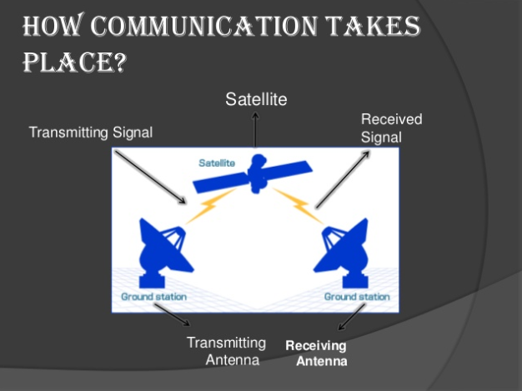

Slide 11
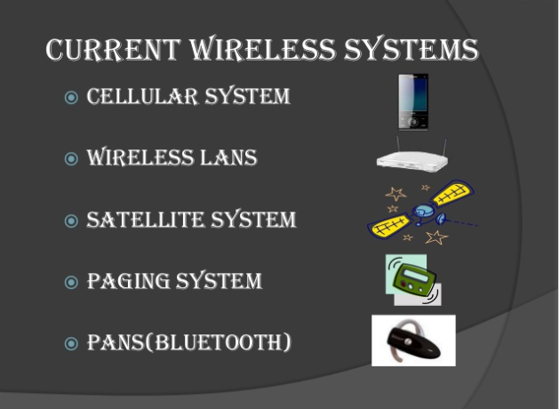

Slide 12
Extra content:
Linear predictive coding :
Linear predictive coding (LPC) is a tool used mostly in audio signal processing and speech processing for representing the spectral envelope of a digital signal of speech in compressed form, using the information of a linear predictive model.
Hamming codes :
Hamming code is a set of error-correction codes that can be used to detect and correct the errors that can occur when the data is moved or stored from the sender to the receiver.
Block code:
A block code is any member of the large and important family of error-correcting codes that encode data in blocks.
Binary Phase Shift Keying (BPSK)
Binary Phase Shift Keying (BPSK) is a two phase modulation scheme, where the 0’s and 1’s in a binary message are represented by two different phase states in the carrier signal: θ=0∘ for binary 1 and θ=180∘ for binary 0.

Slide 13
Important content:
The Quadrature Phase Shift Keying :
The Quadrature Phase Shift Keying (QPSK) is a variation of BPSK, and it is also a Double Side Band Suppressed Carrier (DSBSC) modulation scheme, which sends two bits of digital information at a time, called as digits.
Minimum shift keying
MSK, is a form frequency modulation based on a system called continuous-phase frequency-shift keying.
Minimum shift keying, MSK offers advantages in terms of spectral efficiency when compared to other similar modes.
.

Slide 14
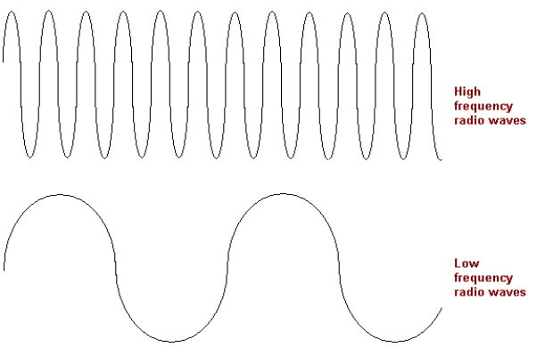
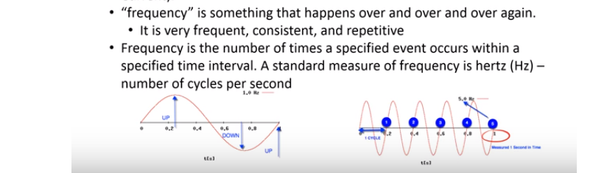
Frequency
Frequency describes the number of waves that pass a fixed place in a given amount of time. So if the it takes for a wave to pass is is 1/2time second, the frequency is 2 per second. If it takes 1/100 of an hour, the frequency is 100 per hour
What does "wavelength" mean?
The wavelength is the distance from the peak of one wave to the next one.

Slide 15
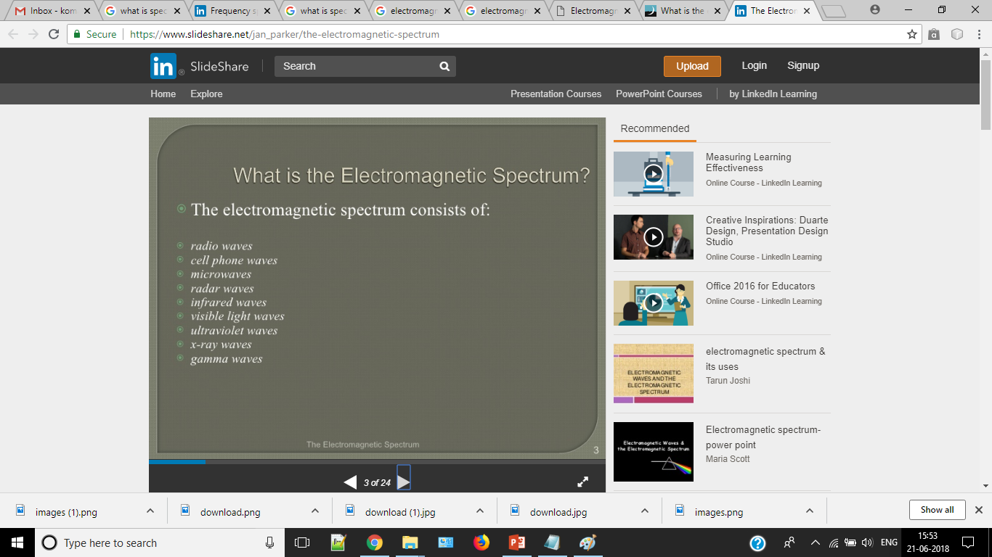
The electromagnetic spectrum describes all the wavelengths of light.

Slide 16
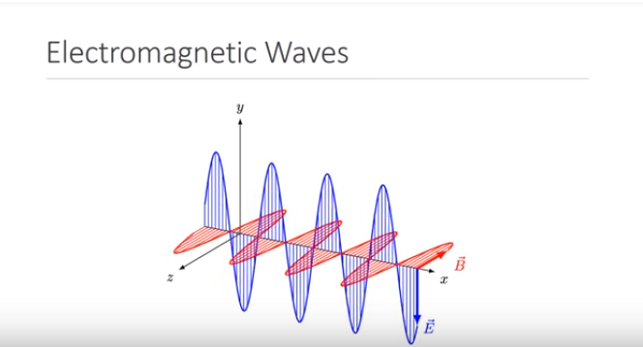

Slide 17
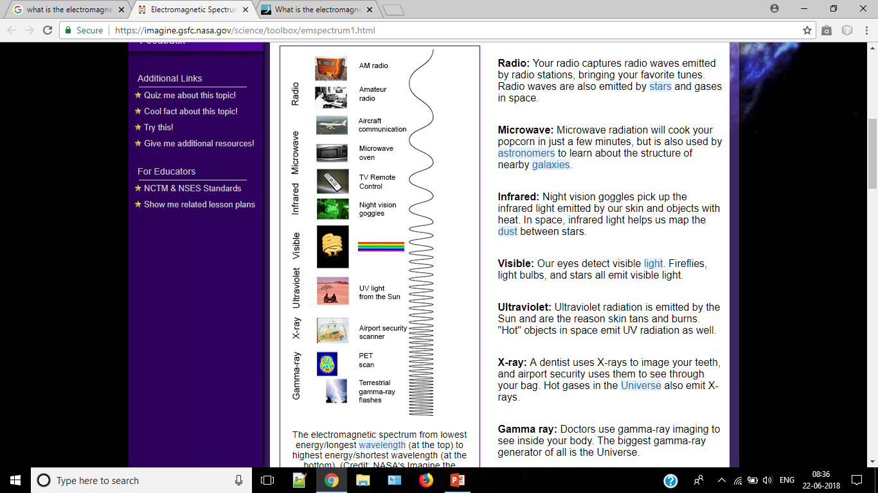

Slide 18
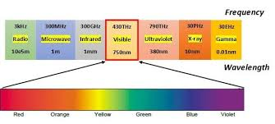
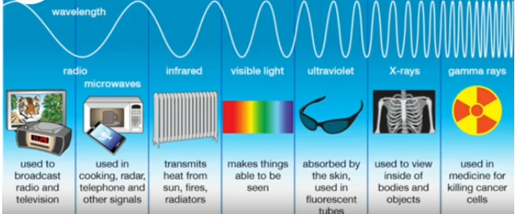

Slide 19
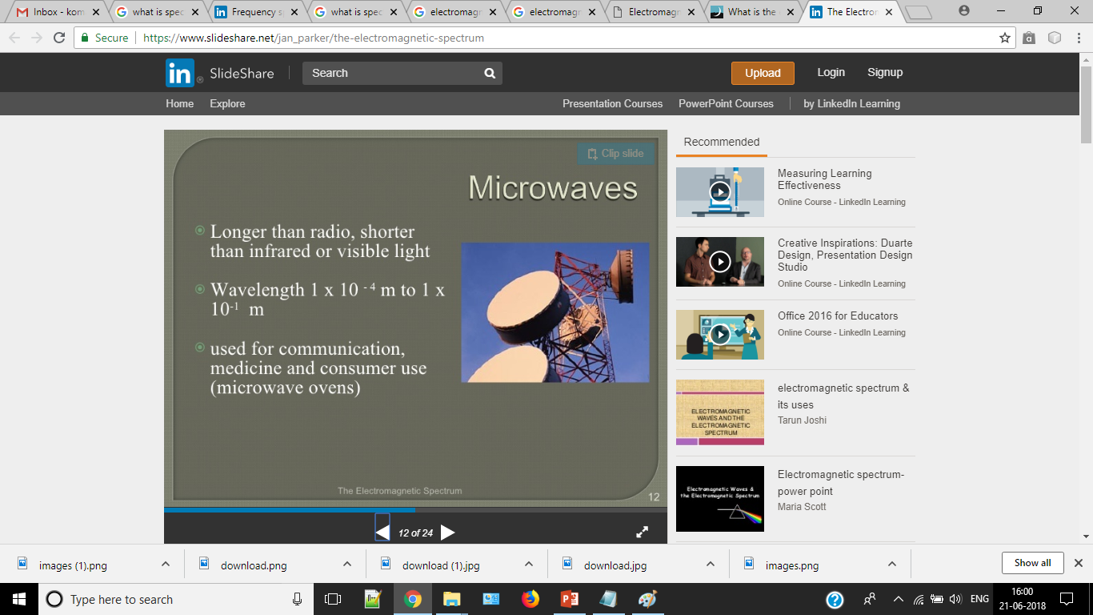
Microwaves
Microwaves range from 1 meter to 1 millimeter and therefore overlap the radio wave band.
Microwaves are good for transmitting information.
Scientists use Microwaves to look for evidence of how the universe began.
Microwaves are basically extremely high frequency radio waves, and are made by various types of transmitter. In a mobile phone, they're made by a transmitter chip and an antenna, in a microwave oven they're made by a "magnetron". Their wavelength is usually a couple of centimeters
Mobile phones use microwaves, as they can be generated by a small antenna, which means that the phone doesn't need to be very big. Wi-Fi also uses microwaves.
Microwaves are also used by fixed traffic speed cameras, and for radar, which is used by aircraft, ships and weather forecasters.

Slide 20
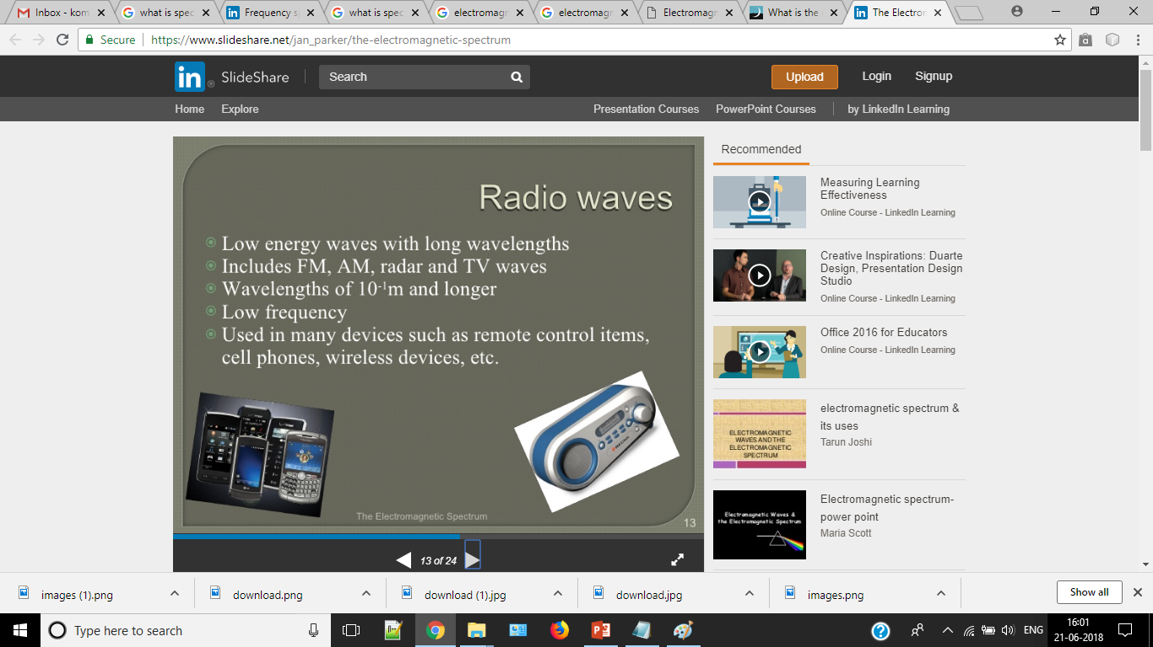

Slide 21
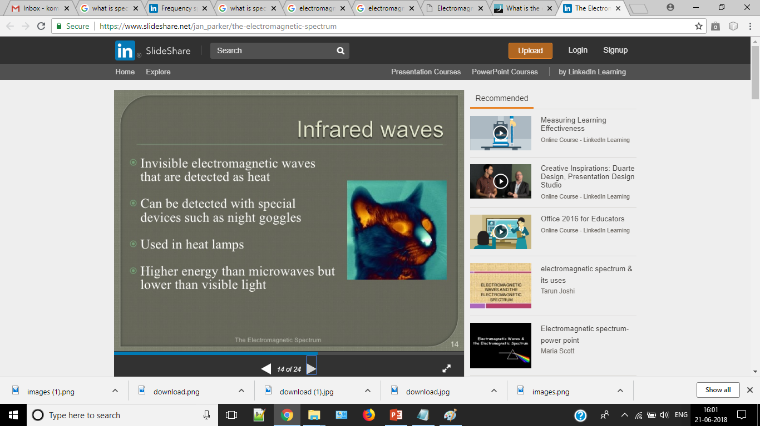

Slide 22
Frequency Spectrum:
An ordered array of the components of a wave is called spectrum.
A frequency spectrum is the range of frequencies of electromagnetic radiation from zero to infinity.
It is a sum of all frequency ranges.
The electromagnetic spectrum was divided into 26 alphabetically designed bands. However, the international telecommunication union(ITU) formally recognizes 12 bands for 30 Hz to 3000 GHz
Radio frequency spectrum
Infrared frequency spectrum

Slide 23
Radio Frequency Spectrum :
It is sum of all the individual channels, each carrying separate into, spread across wide frequency spectrum. We can say RF is a one kind of electromagnetic waves.
The entire spectrum of electromagnetic frequencies is used for communications including frequencies used for radio, radar and television.
The frequency spectrum is generally measured in Hz
The commercial FM radio band operates between 88 and 108 Mhz.
The RF spectrum is commercially used in the form of low band, mid band, commercial band ect.

Slide 24
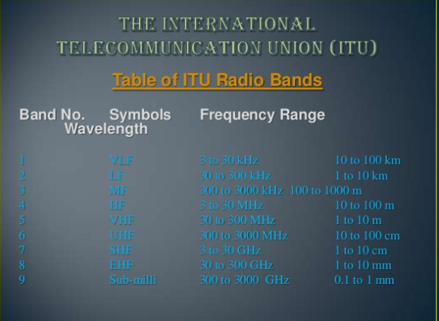

Slide 25
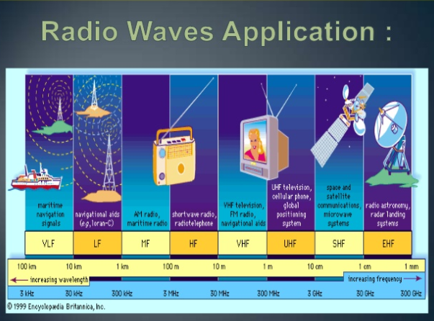

Slide 26
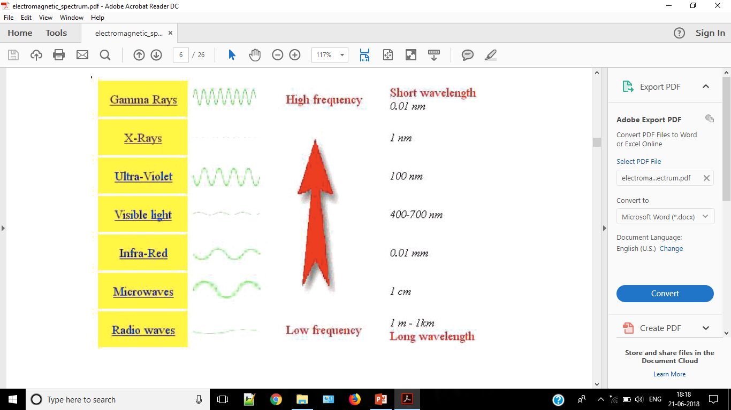

Slide 27
Infrared Frequency Spectrum
Light waves that are slightly longer than visible light waves are IR waves. They are found to the right of visible light in the electromagnetic spectrum.
IR rays create most of the heat from sunlight and burning bulbs
The length of these waves ranges from 10⁻¹² to 10²

